Slide 1
Introduction to Spring Boot
Dr Avishek Nag

Slide 2
What is Spring? https://spring.io/projects/spring-framework
Spring is a framework for building Enterprise Java based applications.
It is a simpler alternative to EJB (Sun’s approach).
It supports a range of architectural styles (MVC, WS, …).
Spring embraces part of the J2EE family:
Servlets (JSR340)
WebSockets (JSR356)
JSON Binding (JSR367)
JPA (JSR338)
…
However, at its core, Spring is a dependency injection framework…

Slide 3
Dependency Injection
Dependency injection is a technique for reducing dependencies between classes.
It is also known as inversion of control.
The idea is to write classes in a way that they can be tested in isolation
Dependencies are created when you write methods that rely on other objects for part of their implementation.
This is problematic when the objects are created/ declared within the same class that they are used.
Testing methods of the class requires that you also implement the dependent classes.
This can lead to a snowball effect where the dependencies themselves have dependencies...

Slide 4
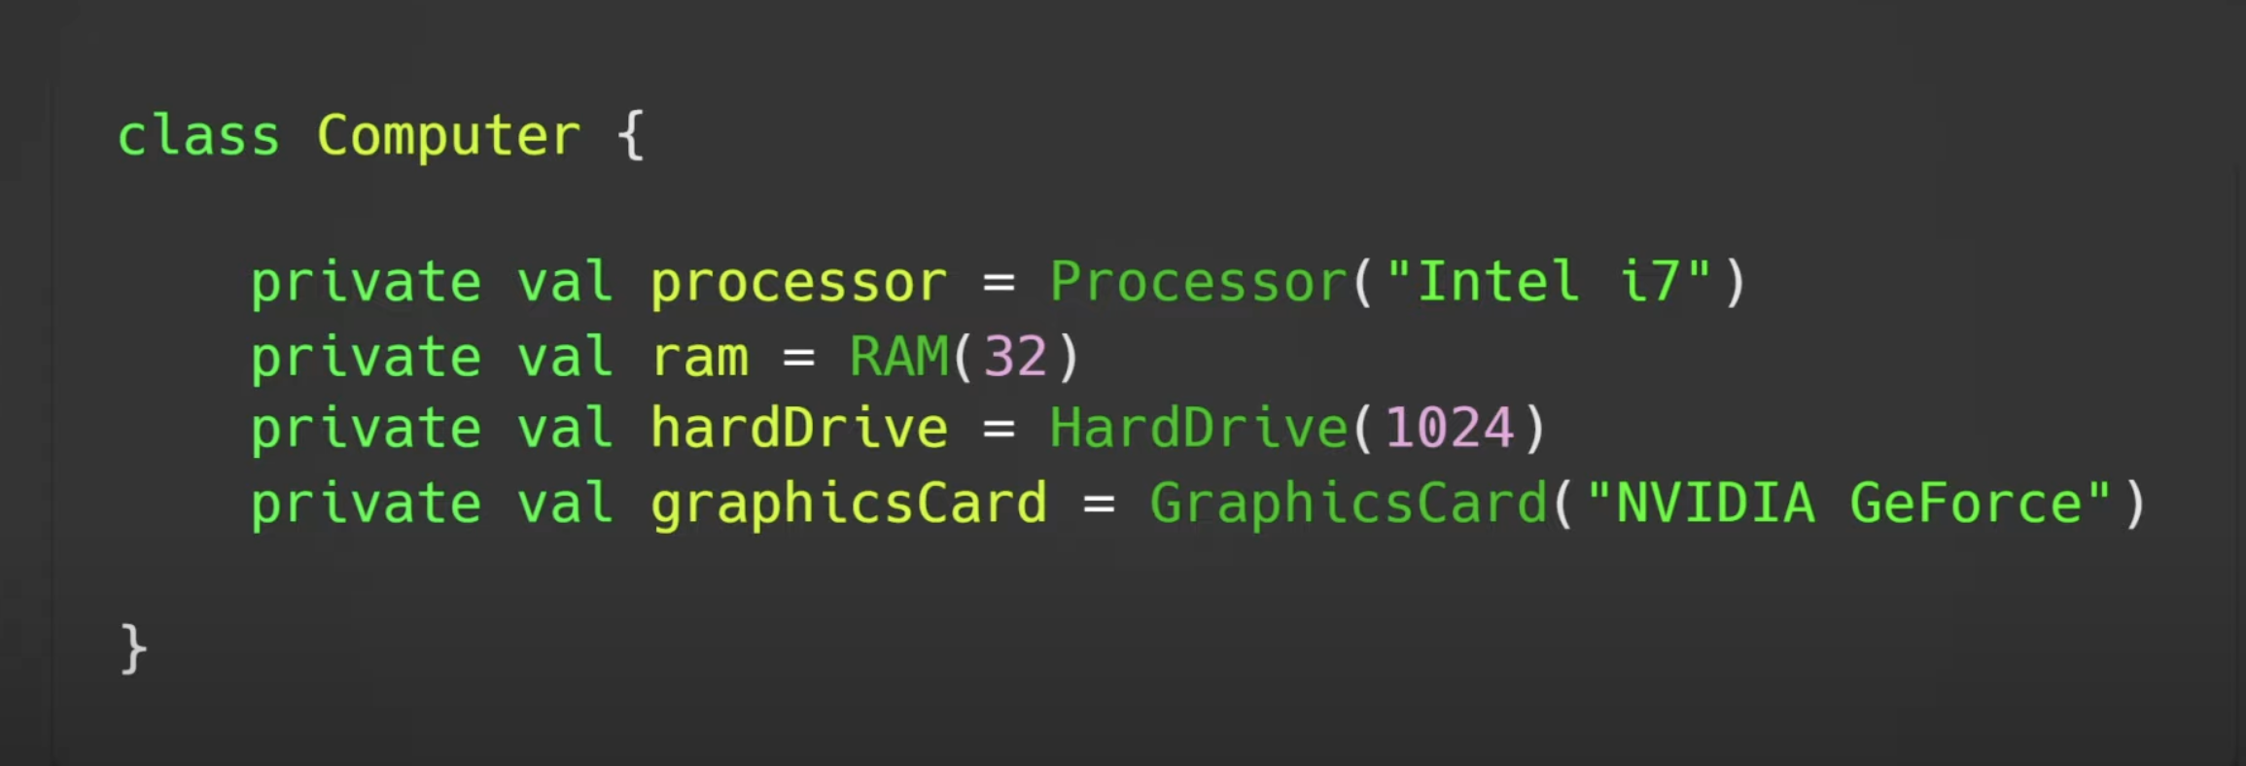
Dependency Injection

Slide 5
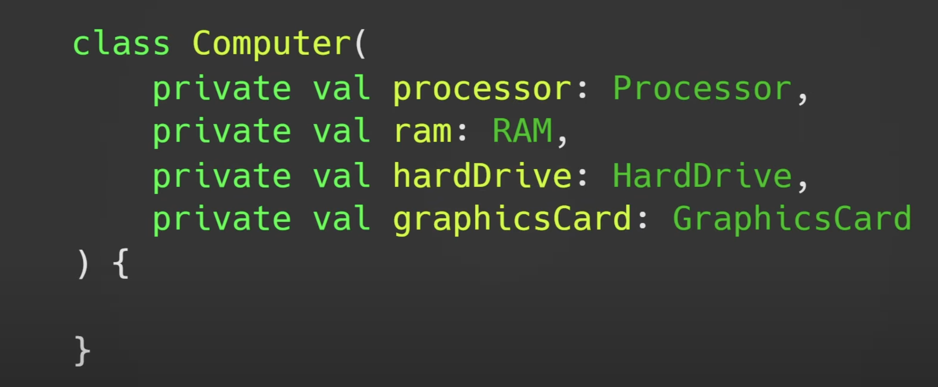
Dependency Injection

Slide 6
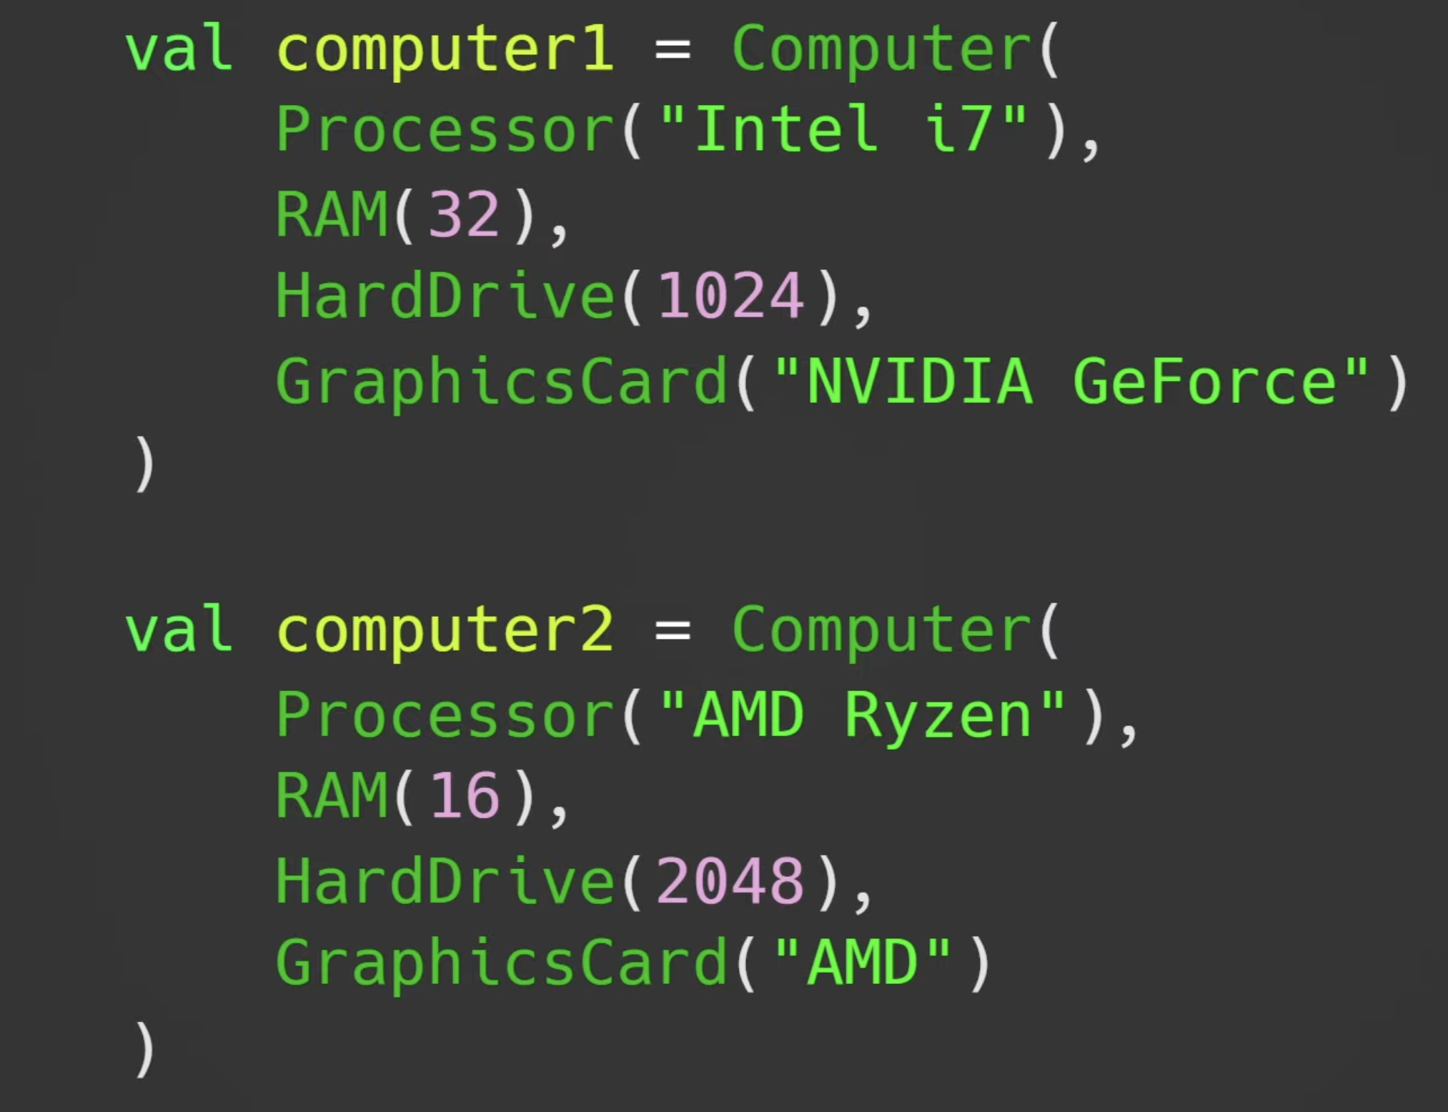
Dependency Injection

Slide 7
Dependency Injection
Dependency injection can be done:
In the constructor (constructor injection)
Through a field (field injection)
As parameters of a method (method injection).
Frameworks like Spring simplify the use of dependency injection by using annotations.
They rely heavily on the Reflection API.
Configuration is managed through XML files.
Spring Boot is an extension of Spring.
Dedicated to the creation of a specific styles of Spring Application (based on best practice).
It removes the need for any XML configuration.

Slide 8
A First Look at Spring Boot

Slide 9
Creating Spring Boot Apps
Spring Boot apps have complex dependencies
Luckily, Spring Boot is designed to work with Build Systems like Maven (or Gradle)!
There is even a website that you can use to create outline projects: Spring Initializr: https://start.spring.io/

Slide 10
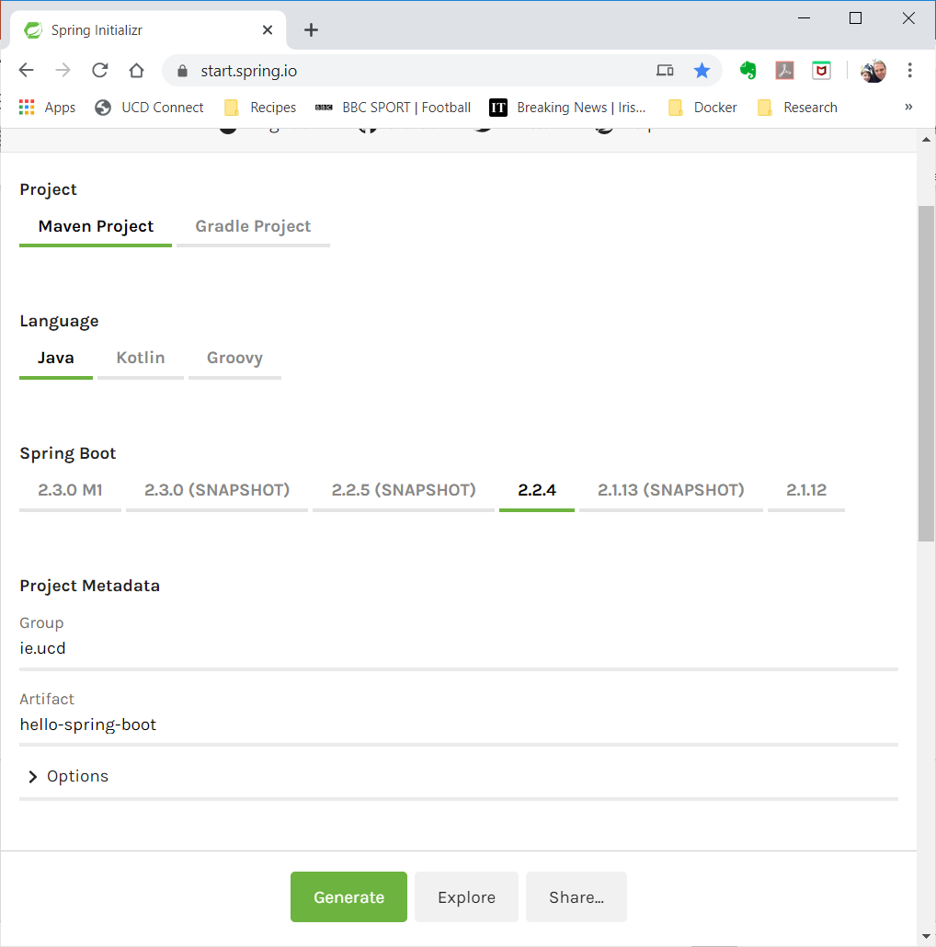
Creating Spring Boot Apps

Slide 11
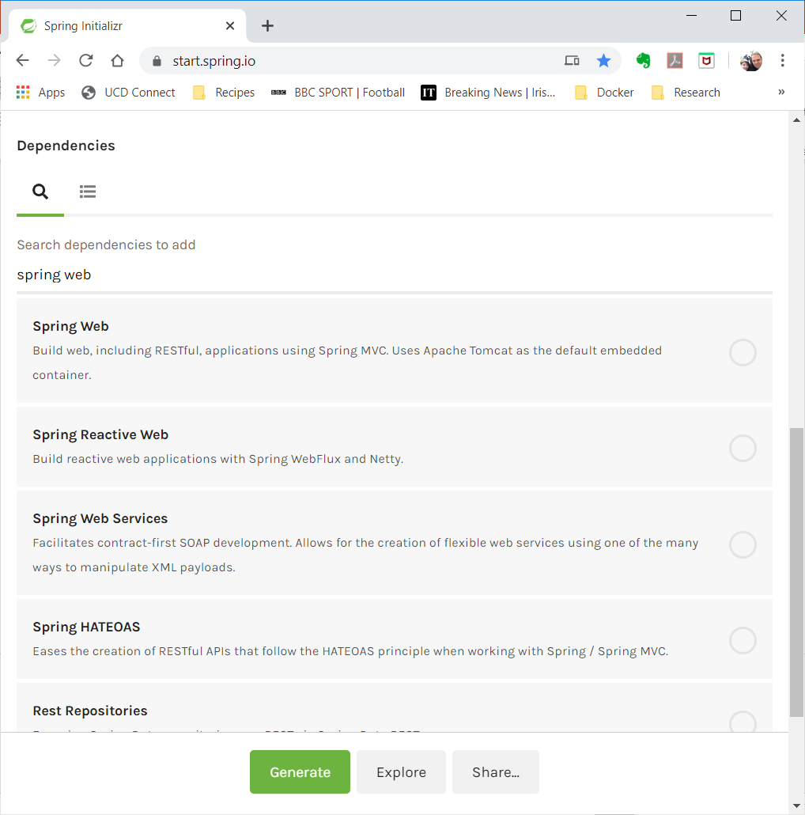
Creating Spring Boot Apps

Slide 12
Creating Spring Boot Apps
Clicking “Generate” creates a maven project with a template application.
<project>
|---src/main
| |---java (contains app)
| |---resources
| |---static (static content)
| |---application.properties
|---src/test/java (unit tests)
|---pom.xml

Slide 13
The Pom.xml File
Spring Boot Projects inherit from a common parent project:
<parent>
<groupId>org.springframework.boot</groupId>
<artifactId>spring-boot-starter-parent</artifactId>
<version>2.2.4.RELEASE</version>
</parent>
This contains the basic dependencies, properties and build plugins needed for SpringBoot…

Slide 14
The Pom.xml File
It also add the dependencies you specified.
For Web Applications, this includes the starter-web library.
<dependency>
<groupId>org.springframework.boot</groupId>
<artifactId>spring-boot-starter-web</artifactId>
</dependency>
It also includes a unit-testing library, but we can omit this for now…

Slide 15
The Pom.xml File
Finally, it adds the spring-boot plugin to support packaging and running of applications.
<plugin>
<groupId>org.springframework.boot</groupId>
<artifactId>spring-boot-maven-plugin</artifactId>
</plugin>
To above plugin allows you to run SpringBoot applications from the command line using:
$ mvn spring-boot:run

Slide 16
The Java Code
By default, the Spring Initializr creates a single Java class:
@SpringBootApplication
public class HelloSpringBootApplication {
public static void main(String[] args) {
SpringApplication.run(
HelloSpringBootApplication.class, args);
}
}
This class is the “main” class of Spring.
The @SpringBootApplication annotation hides a lot of configuration.

Slide 17
The Java Code
To make it do something, we need a controller:
@Controller
public class HelloController {
@GetMapping("/greeting")
public @ResponseBody String greeting() {
return "Hello World";
}
}
Controllers are declared using @Controller.
They map URIs to methods.
They also associate methods with a specific HTTP Verb (GET, POST, …)
Here, the response is the string “Hello World”.

Slide 18
The Java Code
To make it do something, we need a controller:
@Controller
public class HelloController {
@GetMapping("/greeting")
public @ResponseBody String greeting() {
return "Hello World";
}
}
Controllers must be in the same package as, or a sub-package of, the package that contains the main application class.
In our Spring Initializr example, the application class is created in: ie.ucd.hellospringboot

Slide 19
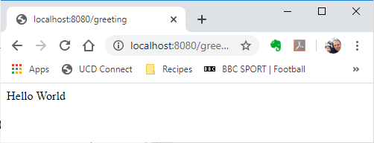
Run It
Download the example program from BrightSpace:
Go to the hello-spring-boot project root folder and type: $ mvn spring-boot:run
Open a browser and type: http://localhost:8080/greeting

Slide 20
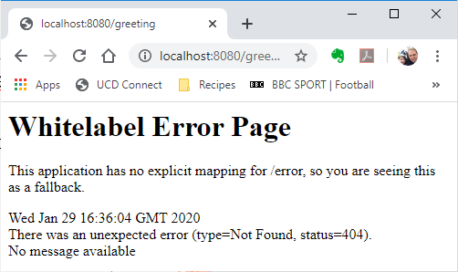
A Test
Change the location of the HelloController class so it is part of the ie package:
Remember to change the package statement.
Rerun the program and reload the page…
Does it work?

Slide 21
Another Test
Change the location of the HelloController class so it is in the ie.ucd.hellospringboot.controller package:
You will need to create this folder.
Again, remember to change the package statement.
Rerun the program and reload the page…
Does it work now?

Slide 22
Final Comment
This ability of SpringBoot to identify controllers by annotating classes is known as auto-configuration.
It is this capability that allows us to use Spring without the need for defining any XML configuration files…

Slide 23
Basic REST APIs with Spring Boot
Dr Avishek Nag

Slide 24
Illustrative “Greetings” Application
Browser
Application
Hanging Controller
/greetings/hanging
Yo! How’s it hangin’
Morrow Controller
/greetings/morrow?sex=...
Good morrow dear {sir/madam}
Hello Controller
/greetings/hello/{name}
Hello {name}
Bye Controller
/greetings/bye/{name}
Bye {name}
Notes:
The @RequestMapping annotation links the method to a URL, and the @RequestParam annotation maps parameters to name-value pairs specified in the requesting URL (e.g. …?name=Rem)

Slide 25
Creating A Spring Greeting Service
REST for Spring Boot is built around the concept of RESTControllers.
These are annotated java classes whose methods implement resources.
package greeting;
@RestController
public class HangingController {
@RequestMapping("/greetings/hanging")
public String hanging() {
return “Yo! Hows it hangin’";
}
}
Key Points:
The @RequestMapping annotation links the method to a URI.
No @ResponseBody annotation is required because we are now working with REST controllers (which don’t support views).
Notes:
The @RequestMapping annotation links the method to a URL, and the @RequestParam annotation maps parameters to name-value pairs specified in the requesting URL (e.g. …?name=Rem)

Slide 26
Creating A Spring Greeting Service
REST for Spring Boot is built around the concept of RESTControllers.
These are annotated java classes whose methods implement resources.
package greeting;
@RestController
public class MorrowController {
@RequestMapping("/greetings/morrow")
public String morrow(@RequestParam String sex) {
return “Good morrow dear “ +
(sex.equals(“male”)? ”sir”:”madam”);
}
}
Key Points:
The @RequestParam annotation maps parameters to name-value pairs specified in the URL query string (e.g. …?sex=male)
Notes:
The @RequestMapping annotation links the method to a URL, and the @RequestParam annotation maps parameters to name-value pairs specified in the requesting URL (e.g. …?name=Rem)

Slide 27
Creating A Spring Greeting Service
REST for Spring Boot is built around the concept of RESTControllers.
These are annotated java classes whose methods implement resources.
package greeting;
@RestController
public class MorrowController {
@RequestMapping("/greetings/morrow")
public String morrow(@RequestParam(“gender”) String sex) {
return “Good morrow dear “ +
(sex.equals(“male”)? ”sir”:”madam”);
}
}
Key Points:
The @RequestParam annotation allows us to map query string names to parameters with different names.
Notes:
The @RequestMapping annotation links the method to a URL, and the @RequestParam annotation maps parameters to name-value pairs specified in the requesting URL (e.g. …?name=Rem)

Slide 28
Creating A Spring Greeting Service
REST for Spring Boot is built around the concept of RESTControllers.
These are annotated java classes whose methods implement resources.
package greeting;
@RestController
public class MorrowController {
@RequestMapping("/greetings/morrow")
public String morrow(
@RequestParam(name=“gender”, defaultValue=“madam")
String sex) {
return “Good morrow dear “ +
(sex.equals(“male”)? ”sir”:”madam”);
}
}
Key Points:
It allows default values to be assigned.
Notes:
The @RequestMapping annotation links the method to a URL, and the @RequestParam annotation maps parameters to name-value pairs specified in the requesting URL (e.g. …?name=Rem)

Slide 29
Creating A Spring Greeting Service
REST for Spring Boot is built around the concept of RESTControllers.
These are annotated java classes whose methods implement resources.
package greeting;
@RestController
public class HelloController {
@RequestMapping("/greetings/hello/{name}")
public String hello(@PathVariable("name") String name) {
return "Hello "+name;
}
}
Key Point:
Path Segments can be mapped to parameters using the @PathVariable(…) annotation.
Notes:
The @RequestMapping annotation links the method to a URL, and the @RequestParam annotation maps parameters to name-value pairs specified in the requesting URL (e.g. …?name=Rem)

Slide 30
Creating A Spring Greeting Service
Controllers are associated with an application by being in the same Java package.
Applications are annotated Java classes in the same package:
package greeting;
@SpringBootApplication
public class Application {
public static void main(String[] args) {
SpringApplication.run(Application.class, args);
}
}
Running this class would create a REST application that is based on all classes annotated with @RestController in the greeting package (or sub-packages).

Slide 31
Combining Resources
All of these can be combined into a single Controller:
@RestController
public class GreetingsController {
@RequestMapping("/greetings/hanging")
public String hanging() { return "Yo! How's it hangin’”; }
@RequestMapping("/greetings/morrow")
public String morrow(@RequestVariable("gender“) String gender) {
return "Good Morrow Dear "+
(gender.equalsIgnoreCase("male") ? "Sir":"Madam");
}
@RequestMapping("/greetings/hello/{name}")
public String hello(@PathVariable("name") String name) {
return "Hello "+name;
}
@RequestMapping("/greetings/bye/{name}")
public String bye(@PathVariable("name") String name) {
return "Bye "+name;
}
}

Slide 32
Combining Resources
You can also define a common base path:
@RestController
@RequestMapping("/greetings")
public class GreetingsController {
@RequestMapping("/hanging")
public String hanging() { return "Yo! How's it hangin’”; }
@RequestMapping("/hello/{gender}")
public String morrow(@PathVariable("gender") String gender) {
return "Good Morrow Dear "+
(gender.equalsIgnoreCase("male") ? "Sir":"Madam");
}
@RequestMapping("/hello/{name}")
public String hello(@PathVariable("name") String name) {
return "Hello "+name;
}
@RequestMapping("/bye/{name}")
public String bye(@PathVariable("name") String name) {
return "Bye "+name;
}
}

Slide 33
Constraining Methods
We often want our resources to response to a subset of HTTP verbs.
For example, our HelloController should only work with GET requests.
These constraints can be applied through the methods field of @RequestMapping.
We can specify a single verb:
@RequestMapping(
value=‘/greetings/hello’,
method=RequestMethod.GET
)
We can specify multiple verbs:
@RequestMapping(
value=‘/hello’,
method={RequestMethod.GET,RequestMethod.POST}
)

Slide 34
Overloaded Resource URLs
Up to now, we have matched the name of the method to the resource URL – this is not required.
In fact, we can associate multiple methods with the same resource URL, but defined for different HTTP verbs:
@RestController
public class GreetingsController {
@RequestMapping(value="/greetings/hanging“,method=RequestMethod.GET)
public String hangingGet() { return "Yo! How's it hangin’”; }
@RequestMapping(value="/greetings/hanging“,method=RequestMethod.POST)
public String hangingPost() { return "Yo! How's it postin’”; }
}

Slide 35
Data Representation and REST
Dr Avishek Nag

Slide 36
Data Representation
Traditionally, APIs have been developed to work with a specific data format:
Distributed Objects Technologies used bit-efficient encodings
Web Services leaned heavily on XML
REST is different because it is built on HTTP:
HTTP is data type agnostic…so, REST is data type agnostic…
The type is determined by specifying a media type in the header.
Some common media types:
text/plain: plain text
text/html: HTML content
application/xml: XML
application/json: JSON

Slide 37
XML
XML - eXtensible Markup Language.
A markup language much like HTML but designed to describe data.
Unlike HTML, you define your own tags.
HTML is about presentation while XML is about representation!
HTML | XML
<html> <body> <h2>John Doe</h2> <p> 2 Backroads Lane<br/> New York<br/> 045935435<br/> john.doe@gmail.com<br/> </p> </body> </html> | <?xml version=1.0?> <contact> <name>John Doe</name> <address>2 Backroads Lane</address> <county>New York</county> <phone>045935435</phone> <email>john.doe@gmail.com</email> </contact>

Slide 38
XML
The structure of an XML document is normally defined in an XML Schema.
Defines what tags can be used; how they can be used; and what types of values are permitted.
Clashes can be overcome by associating schema with namespaces.
<xs:element name="Customer">
<xs:complexType>
<xs:sequence>
<xs:element name="Dob" type="xs:date" />
<xs:element name="Address" type="xs:string" />
</xs:sequence>
</xs:complexType>
</xs:element>
<Customer>
<Dob>2000-01-12T12:13:14Z</Dob>
<Address>
34 thingy street, someplace,
sometown, w1w8uu
</Address>
</Customer>
<xs:element name="Supplier">
<xs:complexType>
<xs:sequence>
<xs:element name="Phone“ type="xs:integer"/>
<xs:element name="Address" type="xs:string"/>
</xs:sequence>
</xs:complexType>
</xs:element>
<Supplier>
<Phone>0123987654</Phone>
<Address>
22 whatever place, someplace,
sometown, ss1 6gy
</Address>
</Supplier>

Slide 39
JSON
JSON (JavaScript Object Notation) has emerged as an alternative to XML:
Originally developed as a means for representing objects in JavaScript.
Rapidly emerged as a data format with the evolution of AJAX (asynchronous JavaScript and XML) due to its more readable format.
JavaScript XML parsers transformed XML data into Object structures that were not intuitive to access when compared with JSON.
Using JSON as both the object representation and the data format offers a far more intuitive model…
This popularity led to JSON being more widely used as a data transfer format…

Slide 40
JSON Syntax
An object is an unordered set of name/value pairs
The pairs are enclosed within braces, { }
There is a colon between the name and the value
Pairs are separated by commas
Example: { "name": "html", "years": 5 }
An array is an ordered collection of values
The values are enclosed within brackets, [ ]
Values are separated by commas
Example: ["html", ”xml", "css"]

Slide 41
JSON Syntax
A value can be: A string, a number, true, false, null, an object, or an array
Values can be nested
Strings are enclosed in double quotes, and can contain the usual assortment of escaped characters
Numbers have the usual C/C++/Java syntax, including exponential (E) notation
All numbers are decimal--no octal or hexadecimal
Whitespace can be used between any pair of tokens

Slide 42
Comparison of JSON and XML
Similarities:
Both are human readable
Both have very simple syntax
Both are hierarchical
Both are language independent
Both can be used with Ajax
Differences:
Syntax is different
JSON is less verbose
JSON can be parsed by JavaScript’s eval method
Names in JSON must not be JavaScript reserved words
XML can be validated through the schema

Slide 43
Processing Data in RESTful Spring Boot Services
Dr Avishek Nag

Slide 44
Data Representation in Spring Boot
Spring Boot cannot be format agnostic – it is an implementation…
Internally, data is modelled using Java Objects
Externally, Spring Boot returns JSON representations of those objects.
Spring uses the Jackson Project for marshalling/unmarshalling of Java Objects to/from JSON.
https://mvnrepository.com/artifact/com.fasterxml.jackson.core
Jackson requires that the objects adhere to the Java Beans specification.
Resources:
Jackson Tutorials: https://www.baeldung.com/jackson
Jackson Homepage: https://github.com/FasterXML/jackson

Slide 45
Java Beans
A standard model for implementing data classes.
All fields are private
All fields have a set/get method to change/read the fields value
A default constructor exists that enables the creation of objects.
Other constructors are also permitted.
Default Constructors:
The default constructor is the constructor that takes no parameters.
If you do not declare a constructor for a class, Java generates a default constructor for you during compilation.
If you specify any constructor, then the default constructor is not generated – then you must explicitly create one.
Because of their structure, Java beans are always serializable

Slide 46
Example: Person Bean
import java.util.Date;
public class Person {
private String firstName;
private String surname;
private Date dateOfBirth;
public String getFirstName() {
return firstName;
}
public void setFirstName(String name) {
this.firstName = name;
}
public String getSurname() {
return surname;
}
public void setSurname(String surname) {
this.surname = surname;
}
public Date getDateOfBirth() {
return dateOfBirth;
}
public void setDateOfBirth(Date date) {
this.dateOfBirth = date;
}
}

Slide 47
Illustration: Howdy Service
We add another greetings service – the howdy service
This returns a JSON object that contains a greeting…
public class Howdy {
public Howdy(String greeting) {
this.greeting = greeting;
}
public Howdy() {} // <-- Default Constructor
private String greeting;
public String getGreeting() {
return greeting;
}
public void setGreeting(String greeting) {
this.greeting = greeting;
}
}

Slide 48
Returning Json Data
Spring Boot automates translation of return values into a response type:
@RestController
public class HowdyController {
@RequestMapping("/greetings/howdy")
public Howdy howdy() {
return new Howdy("Hello there, horse! ");
}
}
The above controller returns a JSON representation of the Howdy object…
{"greeting":"Hello there, horse!"}

Slide 49
Sending Data to A Service
The POST, PUT and PATCH verbs support the transmission of data (creation / replacement / update of a resource).
This data is submitted as part of the body of a HTTP request.
Spring Boot provides the @RequestBody annotation which allows you to map this to a parameter of the method that has been created to handle the operation.
If the associated data class is a Java Bean, then Spring Boot will attempt to transform an incoming JSON payload into an instance of the class.
For example, consider code to update a student resource :
@RestController
public class StudentController {
@RequestMapping(value="/students/{id}",method=RequestMethod.PUT)
public void updateStudent(@PathVariable("id") String id,
@RequestBody Student student) {
studentDatabase.updateStudent(id, student);
}
}

Slide 50
Handling Exceptions
With Spring Boot, you can declare custom exceptions that can be mapped to HTTP response codes.
For example, a 404-not found error can be generated using the following exception
package greeting;
import org.springframework.http.HttpStatus;
import org.springframework.web.bind.annotation.ResponseStatus;
@ResponseStatus(code = HttpStatus.NOT_FOUND, reason = "queue is empty")
public class QueueEmptyException extends RuntimeException {
}
To use it, we simply throw the exception in the method implementation…

Slide 51
Returning XML Data
To return XML data, simply add the following dependency to your pom.xml file:
<dependency>
<groupId>com.fasterxml.jackson.dataformat</groupId>
<artifactId>jackson-dataformat-xml</artifactId>
</dependency>
By default, Spring should now start service application/xml content.
However, if your client uses the Accept: header, then you can now choose what format you want your response in
To do this, we need a better client than a web browser
You should take some time to look at Postman
https://www.postman.com/

Slide 52
Interacting with RESTful Spring Boot Services
Dr Avishek Nag

Slide 53
Interacting With Services
We have seen that Web Browsers provide support for checking REST resources using GET requests
Tools like Postman provide a more comprehensive testing solution but cannot be used to implement client programs.
Here, we will explore 2 ways of working with REST APIs:
Using Standard Java Libraries
Using Spring Boot Rest Templates

Slide 54
Using Standard Java Classes
Java comes with a standard class for interacting with HTTP resources: java.net.HttpURLConnection
The connection is opened when an instance is created.
This means that the order in which you do things matters:
Method followed by Headers followed by Payload…
Using this class can be broken down into 3 main steps:
Creating a connection
Adding the request payload (if one exists)
Processing the response
Processing the response can be further broken down into:
Retrieving the response code
Extracting the response body (if one exists)

Slide 55
HttpURLConnection: Connecting
Creating a connection requires the resource URI and the method you wish to use to connect to that URI:
HttpURLConnection connection =
(HttpURLConnection) new URL(uri).openConnection();
connection.setRequestMethod(method);
Once the connection is defined, you can specify any request headers that you need:
User-Agent: the client that is being used to access the resource:
connection.setRequestProperty("User-Agent","MyDodgyRestClient/1.0");
Accept: comma delimited list of acceptable media types:
connection.setRequestProperty(“Accept",“application/json");
Content-Type: the media type of the request body:
connection.setRequestProperty(“Context-Type",“text/plain");
Content-Length: the size (in bytes) of the request body:
connection.setRequestProperty(“Context-Length",“105");

Slide 56
HttpURLConnection: Request Payload
If your request requires a payload, you must set the Content-Type header.
connection.setRequestProperty(“Content-Type”, “application/json”);
To send a payload with the request, you have to set a flag:
connection.setDoOutput(true);
The payload is represented as bytes:
connection.getOutputStream().write(bytes, 0, bytes.length);
Many applications use String representations of content:
byte[] input = content.getBytes("utf-8");
connection.getOutputStream().write(input, 0, input.length);

Slide 57
HttpURLConnection: The Response
The response code resulting from your request should be retrieved first:
int responseCode = connection.getResponseCode();
How you read the payload depends on the response code…
200-299 response codes:
BufferedReader reader = new BufferedReader(
new InputStreamReader(connection.getInputStream()));
while((line = reader.readLine()) != null) response += line;
300+ response codes:
BufferedReader reader = new BufferedReader(
new InputStreamReader(connection.getErrorStream()));
while((line = reader.readLine()) != null) response += line;
REMEMBER: a HTTP response consists of both the response code and the response payload (if it exists)

Slide 58
A Useful Class…
public class WebUtils {
public static WebResponse sendRequest(String method, String url, String type, String content) {
try {
HttpURLConnection connection = (HttpURLConnection) new URL(url).openConnection();
connection.setRequestMethod(method);
if (type != null) connection.setRequestProperty("Content-Type", type);
connection.setRequestProperty(“User-Agent", “MyDodgyRestClient/1.0”);
if (content != null) {
connection.setDoOutput(true);
byte[] input = content.getBytes("utf-8");
connection.getOutputStream().write(input, 0, input.length);
}
int responseCode = connection.getResponseCode();
String response = "";
BufferedReader reader = null;
String line = null;
if(200 <= responseCode && responseCode <= 299)
reader = new BufferedReader(
new InputStreamReader(connection.getInputStream()));
else
reader = new BufferedReader(
new InputStreamReader(connection.getErrorStream()));
while((line = reader.readLine()) != null) response += line;
return new WebResponse(responseCode, response);
} catch (IOException e) {
e.printStackTrace();
}
return null;
}
}
public class WebResponse {
private int code;
private String payload;
public WebResponse(int c, String p) {
this.code = c;
this.payload = p;
}
public int getCode() {
return code;
}
public String getPayload() {
return payload;
}
}

Slide 59
Using the WebUtils class
public class Hello {
public static void main(String[] args) {
WebResponse response = WebUtils.sendRequest("GET", "http://localhost:8080/greetings/hanging", null, null);
System.out.println("Response Code: " + response.getCode());
System.out.println("Response Payload: " + response.getPayload());
}
}
The above program sends a request to the hanging resource of our greetings app.
The program is modified below sends a request to the howdy resource (which returns JSON).
To transform the payload, we need to use the Jackson Library…
Also, we need to specify the type of response we expect…
public class Hello {
public static void main(String[] args) {
WebResponse response = WebUtils.sendRequest("GET", "http://localhost:8080/greetings/howdy", null, null);
System.out.println("Response Code: " + response.getCode());
System.out.println("Response Payload: " + response.getPayload());
}
}

Slide 60
Using the WebUtils class
In Jackson, all serialization is done through the ObjectMapper class.
The readValue() method can be used to transform JSON into an object…
The program below is further modified below to convert the response of the howdy class into a Java object.
You should remove the Jackson XML dependency when running this code as the WebUtils class does not support custom Accept: headers…
public class Hello {
public static void main(String[] args) {
ObjectMapper mapper = new ObjectMapper();
WebResponse response = WebUtils.sendRequest("GET", "http://localhost:8080/greetings/howdy", null, null);
System.out.println("Response Code: " + response.getCode());
System.out.println("Response Payload: " + response.getPayload());
Howdy howdy = mapper.readValue(response.getPayload(), Howdy.class);
}
}

Slide 61
Using the Spring Boot RestTemplate
If you need to interact with a resource from within a Spring Boot project (service-service interaction), Spring Boot provides a very nice API for implementing REST Clients:
It is based around the RestTemplate class.
This provides a range of methods to execute REST requests.
The return value for each of these methods is a ResponseEntity object, which contains the response from the service.
For example, to invoke the “Hanging” Greeting Service, we can use the following code:
RestTemplate restTemplate = new RestTemplate();
URL uri = new URL("http://localhost:8080/greetings/hanging");
ResponseEntity<String> result =
restTemplate.getForEntity(uri, String.class);
System.out.println("Code: " + result.getStatusCodeValue());
System.out.println(“Content: “ + result.getBody());

Slide 62
Using the Spring Boot RestTemplate
Automated transformation of payloads into Java objects is supported through the getForObject(…) method:
RestTemplate restTemplate = new RestTemplate();
URL uri = new URL("http://localhost:8080/greetings/howdy");
Howdy howdy = restTemplate.getForObject(uri, Howdy.class);
System.out.println(“Greeting: “ + howdy.getGreeting());
To define what media types you accept, you need to define a HTTPHeaders object:
RestTemplate restTemplate = new RestTemplate();
URL uri = new URL("http://localhost:8080/greetings/howdy");
HttpHeaders headers = new HttpHeaders();
headers.setAccept(Collections.singletonList(MediaType.APPLICATION_JSON));
HttpEntity<String> entity = new HttpEntity<>("body", headers);
Howdy howdy = restTemplate.getForObject(uri, entity, Howdy.class);
System.out.println(“Greeting: “ + howdy.getGreeting());

Slide 63
Using the Spring Boot RestTemplate
To submit data to RESTful web services, you use the HttpEntity class.
We used it to set the headers, but it can also be used to set the payload...
For example, to invoke the PUT operation on a student resource, we could use the following code:
HttpEntity<Student> body = new HttpEntity(student);
URL url = new URL("http://localhost:8080/students/"+
student.getId());
ResponseEntity<String> result =
restTemplate.putForEntity(uri, body, String.class);
In general, RestTemplate comes with 2 methods for each verb:
XXXforEntity(…): returns a ResponseEntity that is the result of the REST call
XXXforObject(…): returns the body of the response directly
XXX is one of {put, post, get, delete, …}

